Slide 1
FLOOD PREDICTION USING AI MODEL
DOMAIN :MACHINE LEARNING
BATCH NO:28
PROJECT GUIDE :Mrs. M.S.VINMATHI M.E.,(Ph.D)
TEAM MEMBERS
K SAI HIMAJA (211418104113)
T.V.L DHARANI (211418104293)
T.KUMUDBEN JOSHI (211418104296)

Slide 2
ABSTRACT
Floods are among the most destructive natural disasters, which are highly complex to model.
To prevent this problem to predict flood happen or not by rainfall dataset with investigate the SMLT based techniques.
The research on the advancement of ﬂood prediction models contributed to risk reduction, policy suggestion, minimization of the loss of human life, and reduction the property damage associated with ﬂoods.
To performance in prediction of flood happen or not by accuracy calculation with evaluation classification report, identify the confusion matrix and the result shows that the effectiveness

Slide 3
EXISTING SYSTEM
The increasing growth of machine learning, computer techniques divided into traditional methods and machine learning methods.
This method uses traditional method which is difficult to manage.
The existing method in this project requires large memory and result is not accurate.

Slide 4
DRAWBACKS
More Computation Memory.
Time consuming.
Difficult to handle
They did not mentions any accuracy.

Slide 5
PROPOSED SYSTEM
In proposed system, we implement a Machine Learning algorithms for getting insights from the complex patterns in the data.
This technique is computationally inexpensive because of its simple architecture.
Building the classification model.
The Eligibility of predicting, ML algorithms prediction model is effective because It provides better results in classification problem.

Slide 6
ADVANTAGES
HIGH ACCURACY
TIME SAVING
LOW COMPLEXITIES
COMPUTATIONALLY INEXPENSIVE

Slide 7
Environmental Requirements:
1. Software Requirements:
Operating System : Windows
Tool : Anaconda with Jupyter Notebook
2. Hardware requirements:
Processor : Pentium IV/III
Hard disk : minimum 80 GB
RAM : minimum 2 GB

Slide 8
OVERVIEW
During a flood event, the responsible authorities need to make decisions on operation of barriers and on evacuation/rescue strategies.
Temporary flood protection is sometimes an option and if so it must be decided on quickly. Also people are served by knowing evacuation routes and a forecast of blocked roads.
A system can assist the user by quickly showing the available information on water levels, objects at risk, evacuation routes, etc. This support can be given during the preparation of flood event management or during the actual flood event.

Slide 9
LITERATURE SURVEY
YEAR | PAPER | METHODOLOGY | INFERENCE
2019 | A Hybrid Machine Learning Approach for Classifying Aerial Images of Flood-Hit Areas Akshya .J, P.L.K.Priyadarsini | CLASSIFICATION MODEL. SVM CLASSIFIER. | The classification is done on an image dataset which consists of two subgroups one is aerial images with flood-affected areas and other is aerial images without any flooded affected areas.SVM classifier is used.
2017 | Smart flood disaster prediction system using IOT & Neural Networks Swapnil Bande, Virendra V. Shete | IOT & NEURAL NETWORKS | The integrated approach combines the scalability of IOT and reliability of artificial neural networks to handle data provided by a sensor network and by effective communication between these two components, an early prediction of flood is done

Slide 10
YEAR | PAPER | METHODOLOGY | INFERENCE
2018 | Flood Prediction Using Multi-Layer Artificial Neural Network in Monitoring System with Rain Gauge, Water Level, Soil Moisture Sensors Febus Reidj G. Cruz, Matthew G. Binag, Marlou Ryan G, Francis Aldrine A. | MULTI LAYER ANN | This study was about to implement a real-time monitoring system . The different sensor was integrated into a system, wherein the data was logged and stored. A prediction model based on multi-layered artificial neural network was developed and was tested using an actual setup
2017 | Flood Loss Prediction of Coastal City Based on GM-ANN | ANN and GM | AHP will be used to determine the weight of flood factors. Considering the characteristics of different factors, GM is applied to get predictive values of flood factors. AHP-GM-ANN model was constructed to predict flood loss of coastal city

Slide 11
YEAR | PAPER | METHODOLOGY | INFERENCE
2019 | Floods Prediction Using Radial Basis Function (RBF) Based on Internet of Things (IoT) Ni Komang Ega Kartika, Muhammad Ary Murti, Casi Setianingsih | RBF & IOT | Artificial Neural Networks had been trained on the data that are in the form of water level data and rainfall data which is used to predict the water level and daily rainfall The result from Radial Basis Function Neural Network is sent to an android application that displays the opportunity of flooding.
2018 | Context-based Hydrology Time Series Data for A Flood Prediction Model Using LSTM Indrastanti R. Widiasari, Lukito Edi Nugoho, Widyawan, Rissal Efendi | LSTM | By using LSTM algorithm, the model yielded the MAPE value of 3.6%, it means that the error percentage generated in the model to predict the water level in downstream river is 3.6% compared to the actual data used as testing. When compared to the multiple regression linear, LSTM resulted more accurate water elevation level prediction.

Slide 12
FEASIBILTY STUDY
Data Wrangling:
In this section of the report will load in the data, check for cleanliness, and then trim and clean given dataset for analysis. Make sure that the document steps carefully and justify for cleaning decisions.
Data collection:
The data set collected for predicting given data is split into Training set and Test set. Generally, 7:3 ratios are applied to split the Training set and Test set. The Data Model which was created using Random Forest, logistic, Decision tree algorithms and Support vector classifier (SVC) are applied on the Training set and based on the test result accuracy, Test set prediction is done.

Slide 13
Preprocessing:
The data which was collected might contain missing values that may lead to inconsistency. To gain better results data need to be preprocessed so as to improve the efficiency of the algorithm. The outliers have to be removed. And also data conversion need to be done.
Building the classification model:
The prediction of Phishing Website, A Random Forest Algorithm prediction model is effective because of the following reasons: It provides better results in classification problem.
It is strong in preprocessing outliers, irrelevant variables, and a mix of continuous, categorical and discrete variables.
It produces out of bag estimate error which has proven to be unbiased in many tests and it is relatively easy to tune with.

Slide 14
Construction of a Predictive Model:
Machine learning needs data gathering have lot of past data’s. It’s used to preprocess then, what kind of algorithm with model. Training and testing this model working and predicting correctly with minimum errors. Tuned model involved by tuned time to time with improving the accuracy.

Slide 15
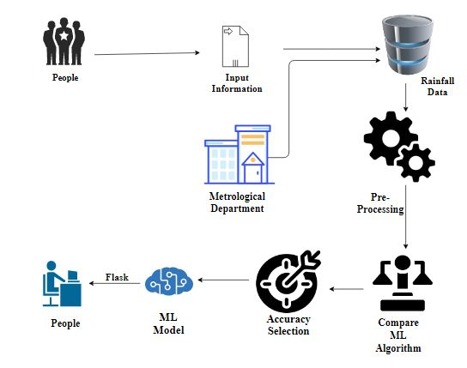
SYSTEM ARCHITECTURE

Slide 16
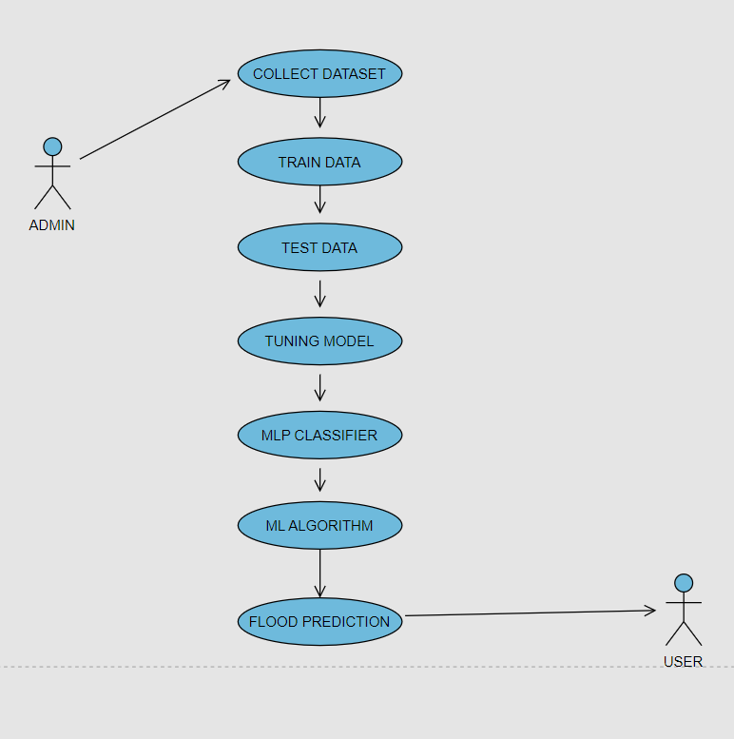
SYSTEM DESIGN USE CASE DIAGRAM

Slide 17
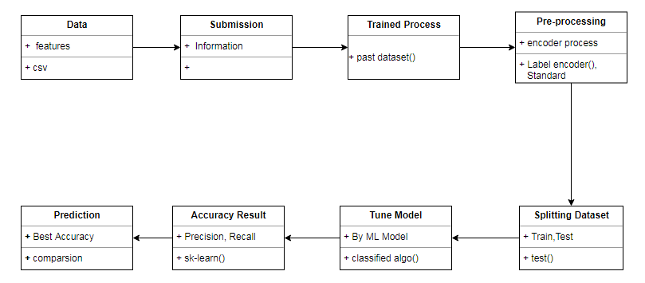
CLASS DIAGRAM

Slide 18
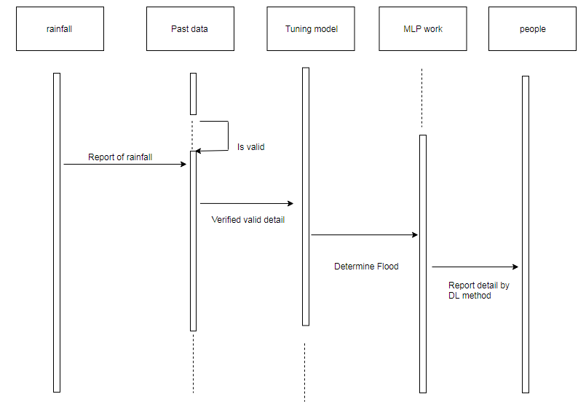
SEQUENCE DIAGRAM

Slide 19
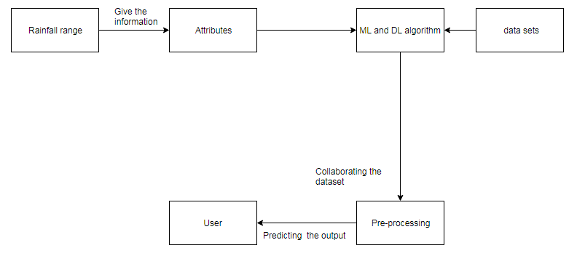
COLLABORATION DIAGRAM

Slide 20
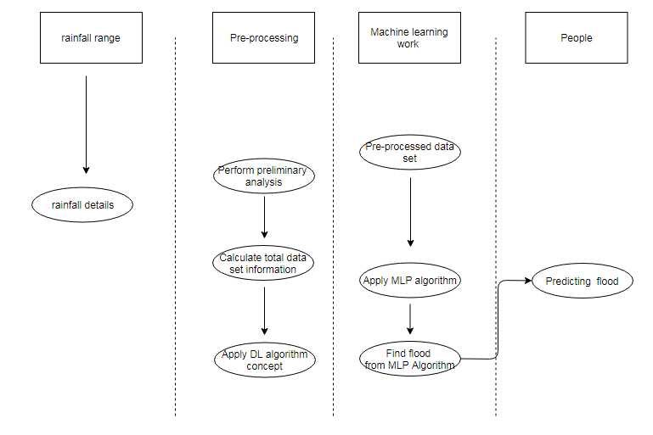
ACTIVITY DIAGRAM

Slide 21
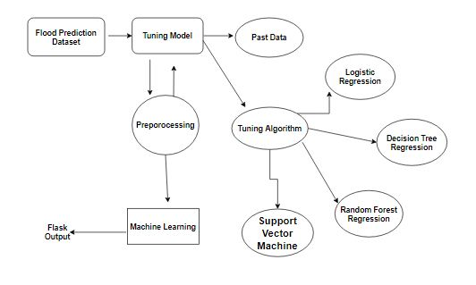
ENTITY RELATIONSHIP DIAGRAM

Slide 22
LIST OF MODULES
Data Pre-processing
Data Analysis of Visualization
Comparing Algorithm with predection in the form of best accuracy result

Slide 23
DATA PRE-PROCESSING
Importing the library packages with loading given dataset. To analyzing the variable identification by data shape, data type and evaluating the missing values, duplicate values.
A validation dataset is a sample of data held back from training your model that is used to give an estimate of model skill while tuning model's and procedures that you can use to make the best use of validation and test datasets when evaluating your models.
The primary goal of data cleaning is to detect and remove errors and anomalies to increase the value of data in analytics and decision making

Slide 24
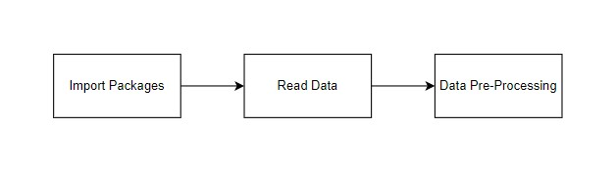
MODULE DIAGRAM
input : data
output : removing noisy data

Slide 25
DATA ANALYSIS OF VISUALISATION
Data visualization is an important skill in applied statistics and machine learning.
Statistics does indeed focus on quantitative descriptions and estimations of data.
Data visualization provides an important suite of tools for gaining a qualitative understanding.
This can be helpful when exploring and getting to know a dataset and can help with identifying patterns, corrupt data, outliers, and much more.

Slide 26
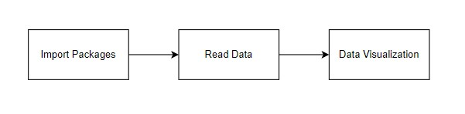
MODULE DIAGRAM
input : data
output : visualized data

Slide 27
COMPARING ML ALOGORITHMS
IN THIS WE WILL COMPARE THE ALGORITHMS AND SEE THE RESULT
WE WILL GIVE INPUT DATA AND APPLY THE ALGORITHM AND GET THE ACCURACY
ONCE WE GET THE ACCURACY WE WILL SELECT THE BEST MODEL
AND THE MODEL WHICH IS SELECTED WILL DEPLOY USING FLASK

Slide 28
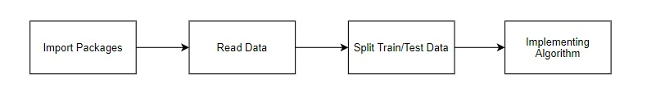
MODULE DIAGRAM
INPUT: DATA
OUTPUT:ACCURATE PREDICTION

Slide 29
MODEL USED IN EXSISTING
The method used in the existing is a traditional method .In which the metrological department uses satellite view and with help of machines they will measure the amount of rainfall.
They also collect river data and the amount of rainfall and soil moisture and everything .
After analyzing all these data they will predict the flood will happen or not.

Slide 30
ALGORITHM USED IN PROPOSED SYSTEM
Logistic Regression:
The goal of logistic regression is to find the best fitting model to describe the relationship between the dichotomous characteristic (in which there are only two possible outcomes) of interest (dependent variable = response or outcome variable) and a set of independent (predictor or explanatory) variables.
STEP1: Logistic regression is a Machine Learning classification algorithm that is used to predict the probability of a categorical dependent variable.
STEP2: The dependent variable is a binary variable that contains data coded Y = 1 (yes, success, etc.) or 0 (no, failure, etc.).

Slide 31
STEP3: In other words, the logistic regression model predicts P(Y=1) as a function of X.
Assumptions:
For a binary regression, the factor level 1 of the dependent variable should represent the desired outcome.
Only the meaningful variables should be included.
The independent variables should be independent of each other. The independent variables are linearly related to the log odds.
Logistic regression requires quite large sample sizes.

Slide 32
DECISION TREE ALOGRITHM
Decision tree builds classification or regression models in the form of a tree structure.
STEPS:
STEP1: Firstly it breaks down a data set into smaller and smaller subsets while at the same time an associated decision tree is incrementally developed.
STEP2: A decision node has two or more branches and a leaf node represents a classification or decision.

Slide 33
STEP3: The topmost decision node in a tree that corresponds to the best predictor is called the root node.
STEP4: It utilizes an if-then rule set that is mutually exclusive and exhaustive for classification. The rules are learned sequentially using the training data one at a time.
STEP5: This process is continued on the training set until meeting a termination condition. It is constructed in a top-down recursive divide-and-conquer manner.

Slide 34
RANDOM FOREST CLASSIFIER
Random forests or random decision forests are an ensemble learning method for classification, regression, and other tasks, that operate by constructing a multitude of decision trees at training time and outputting the class that is the mode of the classes (classification) or mean prediction (regression) of the individual trees.
STEPS:
STEP 1: Pick N random records from the dataset.
STEP2: Build a decision tree based on these N records.
STEP3: Choose the number of trees you want in your algorithm and repeat steps 1 and 2.

Slide 35
STEP4: In case of a regression problem, for a new record, each tree in the forest predicts a value for Y (output).
STEP5: The final value can be calculated by taking the average of all the values predicted by all the trees in
STEP6: Or, in case of a classification problem, each tree in the forest predicts the category to which the new record belongs.
STEP7: Finally, the new record is assigned to the category that wins the majority vote.

Slide 36
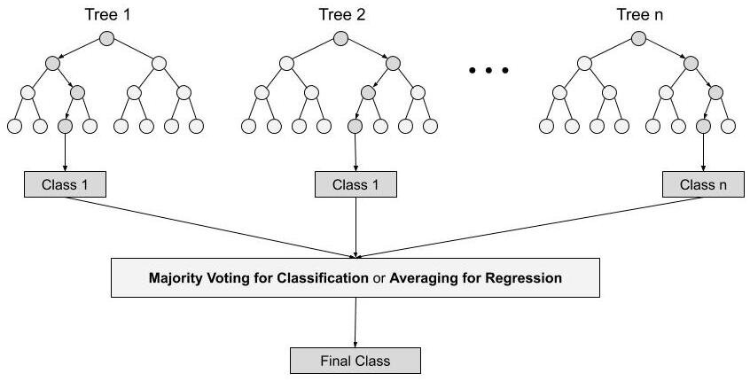

Slide 37
SUPPORT VECTOR MACHINE
A classifier that categorizes the data set by setting an optimal hyperplane between data. I chose this classifier as it is incredibly versatile in the number of different kernelling functions that can be applied and this model can yield a high predictability rate.
STEPS:
STEP1: Let us consider two tags, yellow and blue, and our data has two features, x, and y. Given a pair of (x,y) coordinates, we want a classifier that outputs either yellow or blue. We plot the labeled training data on a plane.
STEP2: An SVM takes these data points and outputs the hyperplane, which is simply a line in two-dimension, that best separates the tags. The line is the decision boundary. Anything falling to one side of it will be classified as yellow, and anything on the other side will be classified as blue.

Slide 38
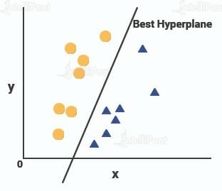
STEP3: For SVM, the best hyperplane is the one that maximizes the margins from both tags. It is the hyperplane whose distance to the nearest element of each tag is the largest.
STEP4: Whereas in three dimensional plane we don’t have a simple line separating these two classes. So we’ll extend our dimension and introduce a new dimension along the z-axis. We can now separate these two classes.

Slide 39
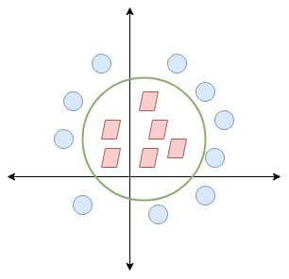
STEP5: When we transform this line back to the original plane, it maps to the circular boundary as I’ve shown here.
STEP6: This is exactly what SVM does! It tries to find a line/hyperplane (in multidimensional space) that separates these two classes. Then it classifies the new point depending on whether it lies on the positive or negative side of the hyperplane depends on the classes to predict.

Slide 40

SCREEN SHOTS

Slide 41
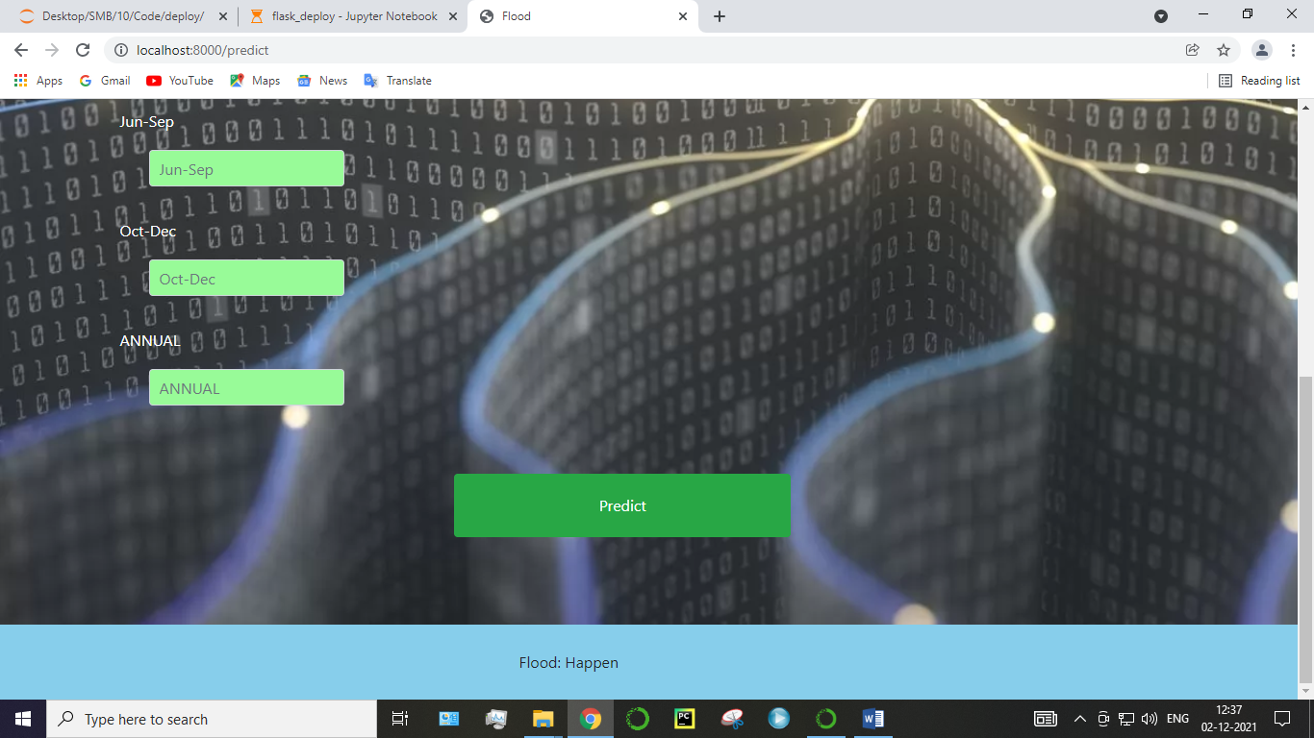

Slide 42
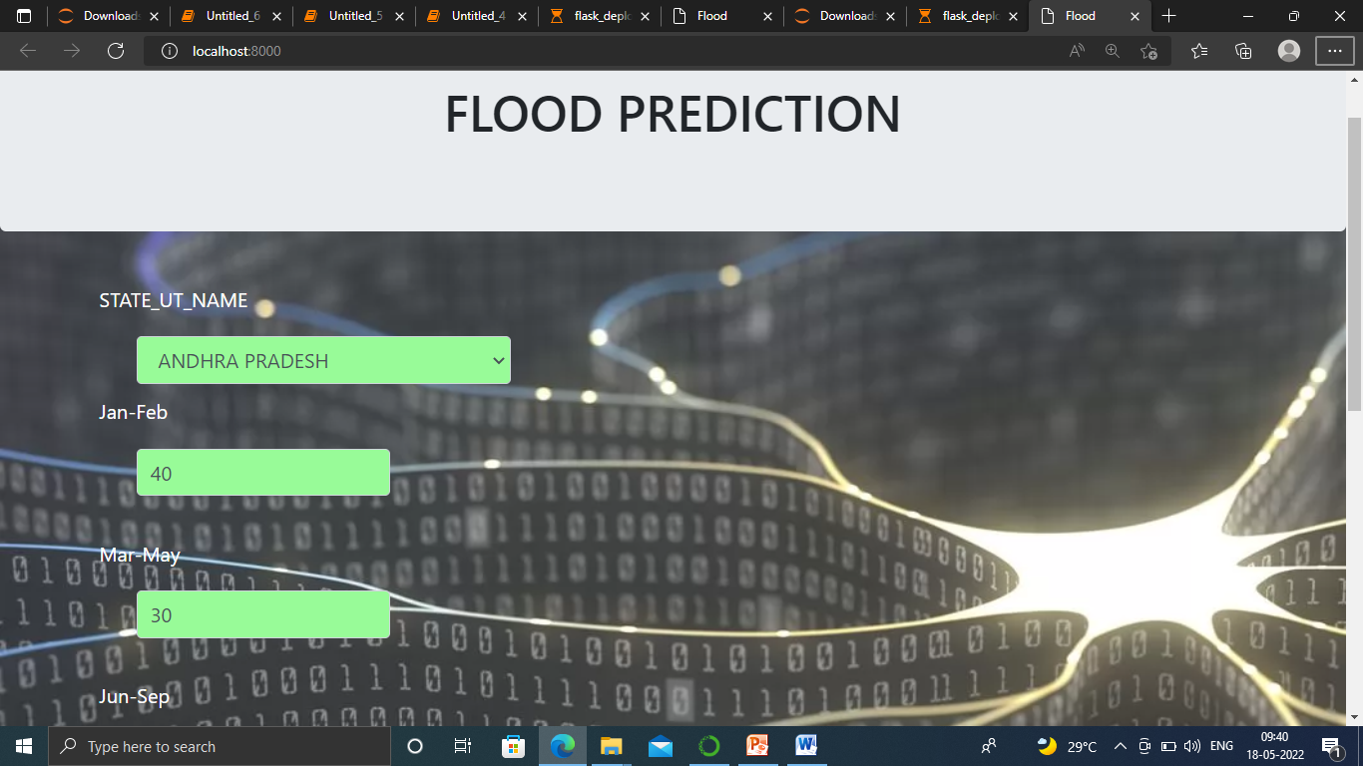

Slide 43
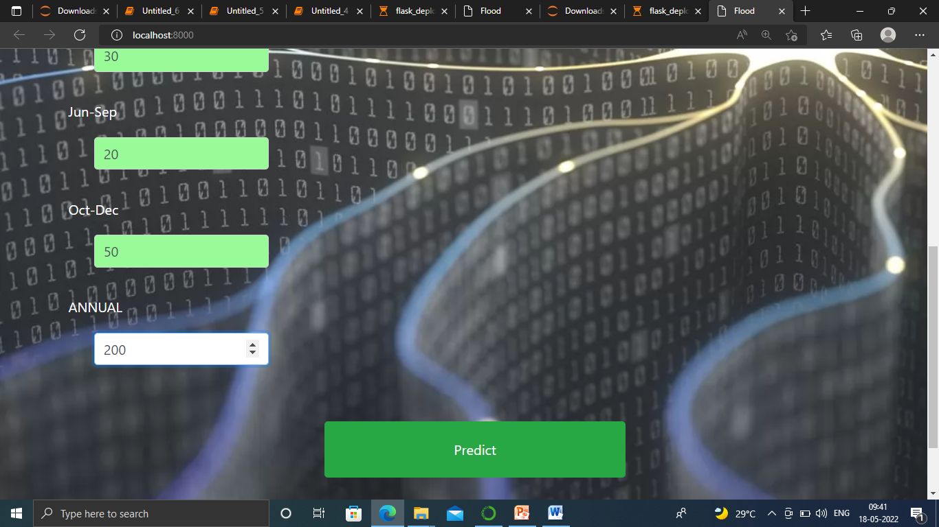

Slide 44
CONCLUSION
The analytical process started from data cleaning and processing, missing value, exploratory analysis and finally model building and evaluation.
Finally we predict the flash flood using machine learning algorithm with different results. This brings some of the following insights about flood prediction

Slide 45
Future Enhancement:
Disaster management wants to automate the detecting the flood happened or not from eligibility process (real time).
To automate this process by show the prediction result in web application or desktop application.
To optimize the work to implement in Artificial Intelligence environment

Slide 46
REFERENCE
[1]K. Smith, Environmental hazards: assessing risk and reducing disaster. Routledge, 2003.
[2] Z. Sen, Flood Modeling, Prediction and Mitigation, 1st ed. Springer International Publishing, 2018.
[3] A. Y. Sun and B. R. Scanlon, ‘‘How can big data and machine learning benefit the environment and water management: A survey of methods, applications, and future directions,’’ Environ. Res. Lett., vol. 14, no. 7, p. 28, 2019.
[4] C. Cortes and V. Vapnik, ‘‘Support-vector networks,’’ Mach. Learn., vol. 20, no. 3, pp. 273–297, 1995.

Slide 47
[5] K. Kravari and N. Bassiliades, “A survey of agent platforms,” Journal of Artificial Societies and Social Simulation, vol. 18, no. 1, p. 11, 2015
[6] M. Westergaard and H. Verbeek, “Cpn tools.” [Online]. Available: http://cpntools.org/
[7] Ö. Kişi, ‘‘Streamflow forecasting using different artificial neural network algorithms,’’ J. Hydrol. Eng., vol. 12, no. 5, pp. 532–539, Sep. 2007
[8] Glossary of Meteorology (June 2000) Flood Archived 2007-08-24 at the Wayback Machine, Retrieved on 2009-01-09

Slide 48
THANK YOU

